Slide 1
Shell Bootcamp 2024 3 Reflections for Week #2
Uditi Gupta
Date : 30-Aug-2024

Slide 2

About Me
You either be as you seem or seem as you are. There is only one life, do your best and stand out. Spread happiness.

Slide 3

My learnings from this week!

Slide 4
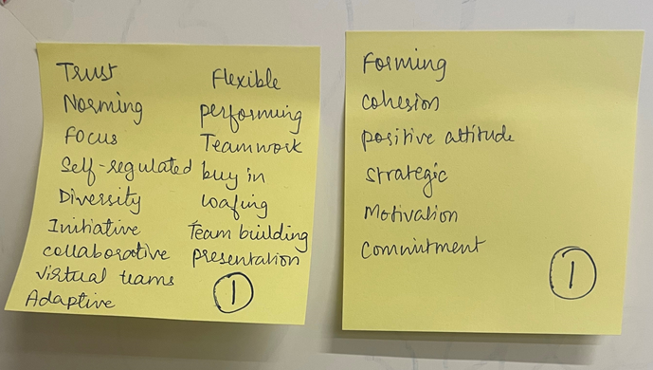
Learning 1 | My takeaways
Things we Learned in soft skills (Day-1) are -
Interpersonal Relationship management
C2C (Campus to corporate transition)
Collaboration with team
Plan, organize, write, edit, review for self assessment
Professional qualities
Self discipline
Email etiquette
Grooming

Slide 5
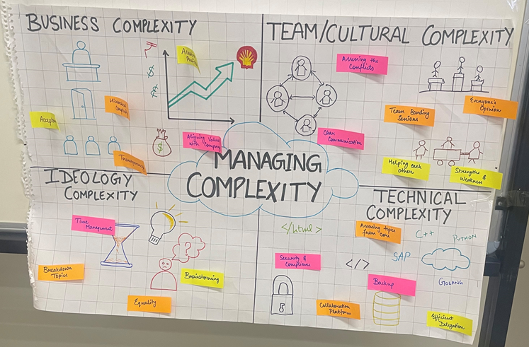
Learning 2 | My takeaways
Things we Learned in softskills (Day-2,3) are -
Positive attitude and mindset
Etiquettes for mobile, meetings, emails, and groups
Stakeholder management
Inform, monitor, satisfy, collaborate, and manage closely
Managing stakeholder expectations
Dedication

Slide 6
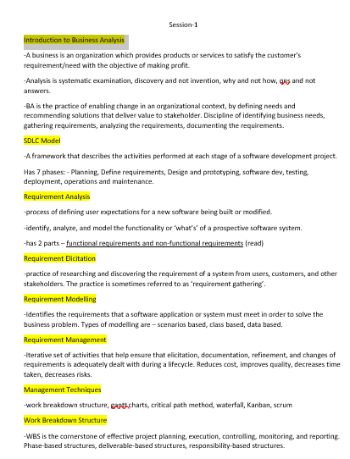
Learning 3 | My takeaways
Things we Learned in Technical (Day-4,5) are –
Introduction to BA
SDLC Model
Requirement Analysis
Requirement elicitation
Requirement modelling
Requirement management
Management Techniques
Gantt chart, work breakdown structure, critical path method, Requirement traceability, waterfall, scrum, sprint, azure devops, epic-story-task-sub task

Slide 7

Relevance of learnings for my organization

Slide 8
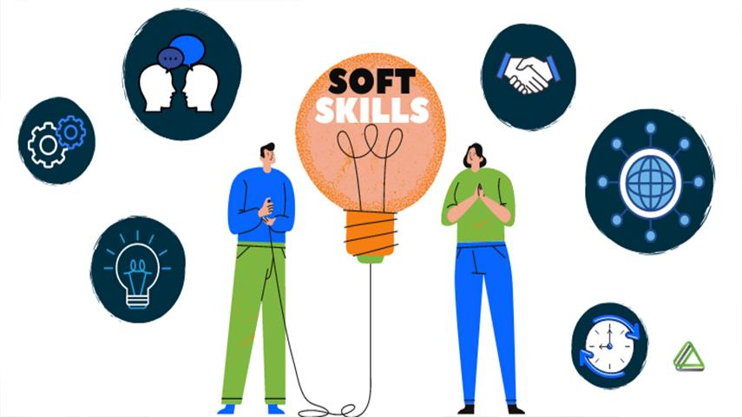
Learning 1 | Relevance for Shell
Soft skills such as organization, leadership, communication, and problem-solving enhance efficiency for both the company and its employees. This is particularly important at Shell, where networking and technical skills are crucial. These abilities enable workers to be more productive and consistently meet or surpass standards and deadlines.

Slide 9
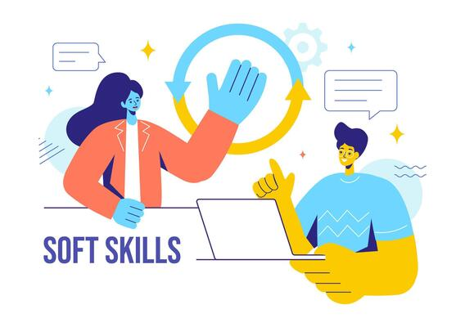
Learning 2 | Relevance for Shell
Soft skills enhance effective communication, promote creative problem-solving, and cultivate professional camaraderie, thereby boosting our company’s productivity. In their absence, teams and departments may face challenges such as communication breakdowns, conflicts, and inefficiency.
[Add a graphic that provides view of how Shell implements this learning]

Slide 10

Learning 3 | Relevance for Shell
Business Analysis (BA) has provided numerous benefits for us at Shell. It enables informed decision-making, boosts revenue, and enhances operational efficiency by minimizing disruptions once decisions are properly made. BA involves iterative activities that ensure requirements are elicited, documented, refined, and managed throughout the lifecycle. This approach reduces costs, improves quality, shortens timelines, and mitigates risks. Additionally, AGILE offers advantages such as superior product quality, customer satisfaction, better control, improved project predictability, reduced risks, increased flexibility, and continuous improvement.
[Add a graphic that provides view of how Shell implements this learning]

Slide 11

Challenges in implementing learning

Slide 12
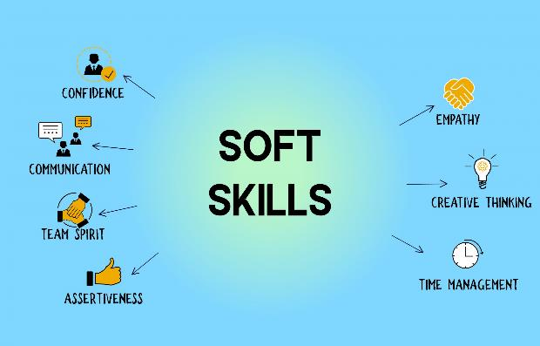
Challenge faced while implementing Learning 1
No challenges faced specially for the soft-skills class because every learning was depicted properly and moreover, we played skits and did role play to understand how things work. We might not have got best at it but did get good gist of it.
uditi-12/journey-ppt (github.com)

Slide 13

Challenge faced while implementing Learning 2
Teamwork could’ve been a little problem when arranged with certain people as they might be rigid and not so welcoming sometimes but that can also be overcome.
uditi-12/journey-ppt (github.com)

Slide 14

Challenge faced while implementing Learning 3
I was new to BA and Agile as I didn’t study that in my college, but facilitator taught it so well that it felt easy later. The sessions were great, very interesting. Implementation, software development and all other things might take a little time as we will become familiar with it slowly, but it will be worth it.
uditi-12/journey-ppt (github.com)

Slide 15

Action Plan

Slide 16
My Action Plan for this Week
Actions
Timeline
Status
Practicing Behavioural skills, BA & Agile and DBMS
Saturday – Brush up concepts of softskills
Sunday – BA & Agile with notes of DBMS
Status of the same by the end of the week

Slide 17

Learning is also Fun!

Slide 18
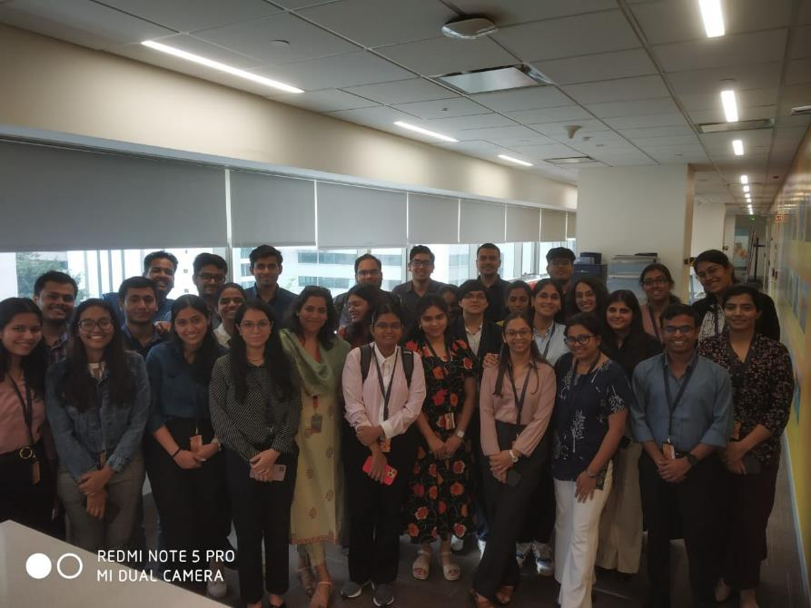
Learning is also Fun!
She was empathetic, she accepted us the way we are, she understood that every question can be subjective, so she said that no answers are right or wrong. She is a person of great knowledge enlightening us with years of experience she had through her case studies. Exciting, engaging, fun, with a lot of learning which made the sessions fun. Our technical ma’am was also great. She always tried to make class interesting coming up with jokes. Our technical sessions were the most fun!!

Slide 19

Summary
Learned softskills, BA & agile
Will revise DBMS learned from college
Software setup is needed.

Slide 20
Thank You

